Slide 1
AUTOMATED DIRECTION DETECTING BOT
B.TECH. PROJECT
AAYUSH MISHRA 16095001
ASHWINI RAJ 16095013
KARTIKEY SINGH 16095029
KUSHAGRA SHARMA 16095033
Under the Supervision of Dr. V. N. Mishra

Slide 2
OBJECTIVE
To create an automated wireless bot that captures an image, processes it and then traverses according to the direction detected while avoiding any obstructions in the path.

Slide 3
APPLICATIONS
Automated vehicles to move in constrained environment like wildlife sanctuaries and recreational parks.
Helping people with disabilities to charter the course.
Accident and collision prevention by using sensors and artificial intelligence.

Slide 4
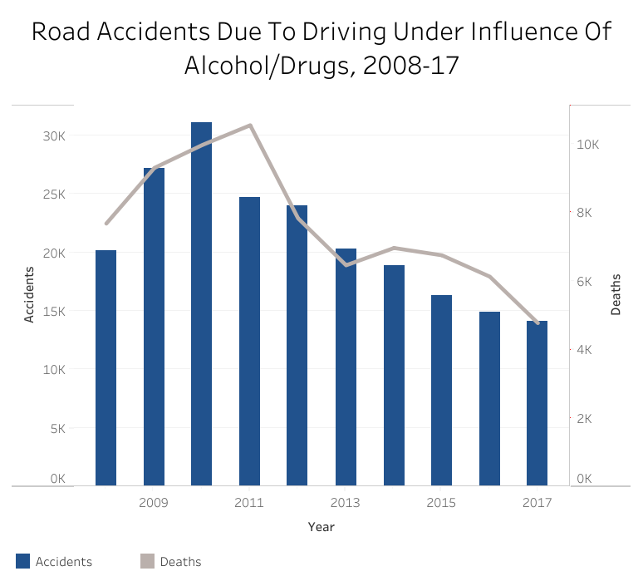
Each year more than 10% of accidents are due to intake of alcohol/drugs.

Slide 5
How are we solving this?
We are using image processing to get desired components out of the image which will be used further.
Then using deep learning method named convolutional neural networks we detect and classify images.
Also, according to our needs we are sending signals to the bot to move in certain directions and preventing its collision using ultrasonic sensors.

Slide 6
INTRODUCTION
The bot uses Pi camera attached to Raspberry Pi for capturing images which are then classified using TensorFlow and according to the direction detected the L298n motor driver is given an input which drives the motors and uses HC-SR04 ultrasonic sensors for avoiding obstacles in its path.
We have used two power sources of 5V and 9V to drive Raspberry Pi and L298n motor driver respectively and to make the bot wireless.

Slide 7
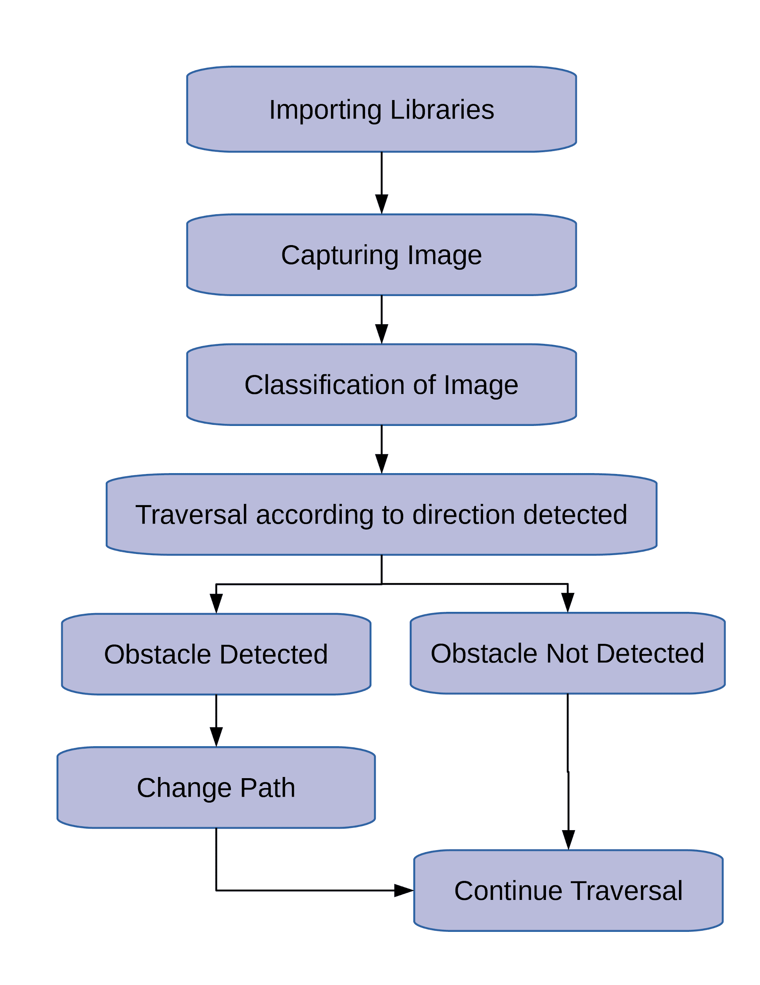

Slide 8
Components and Technologies
Raspberry Pi 3
Raspberry Pi Camera
L298n Motor Driver Module
TensorFlow
Python
SSH(Secure Shell)
VNC
DC Motor
Power Source for Raspberry Pi

Slide 9
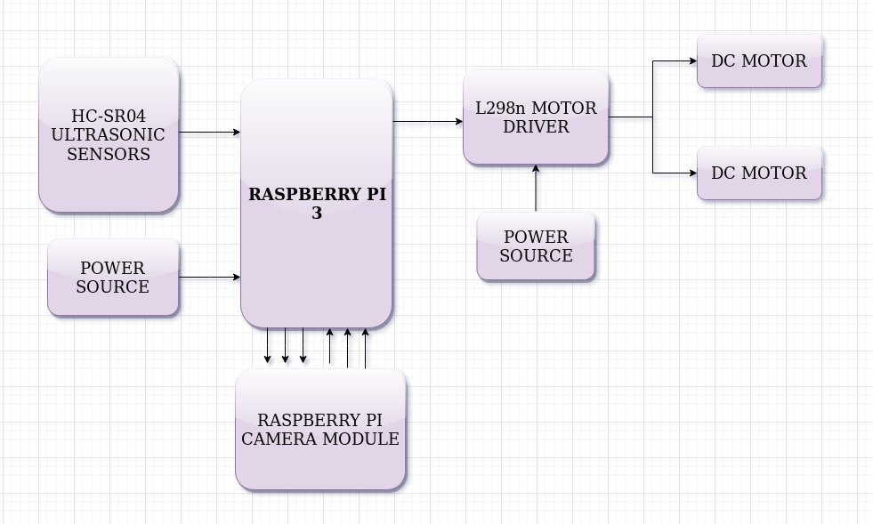

Slide 10
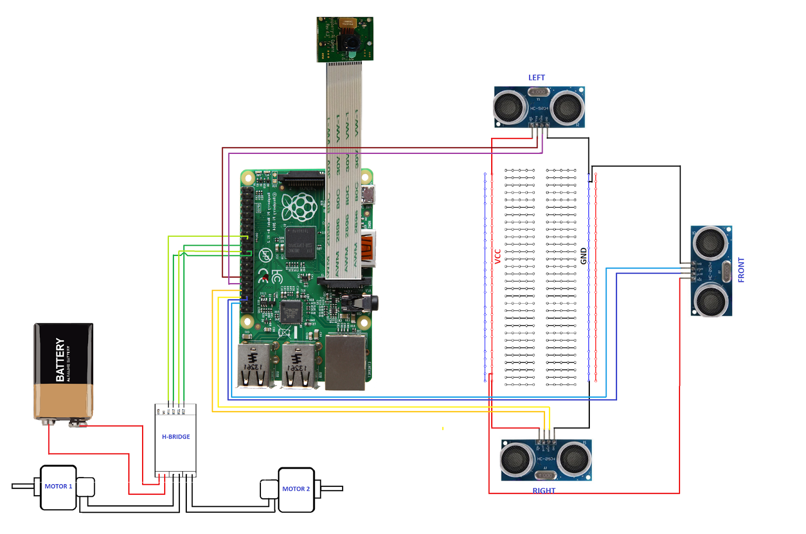
Circuit Diagram

Slide 11
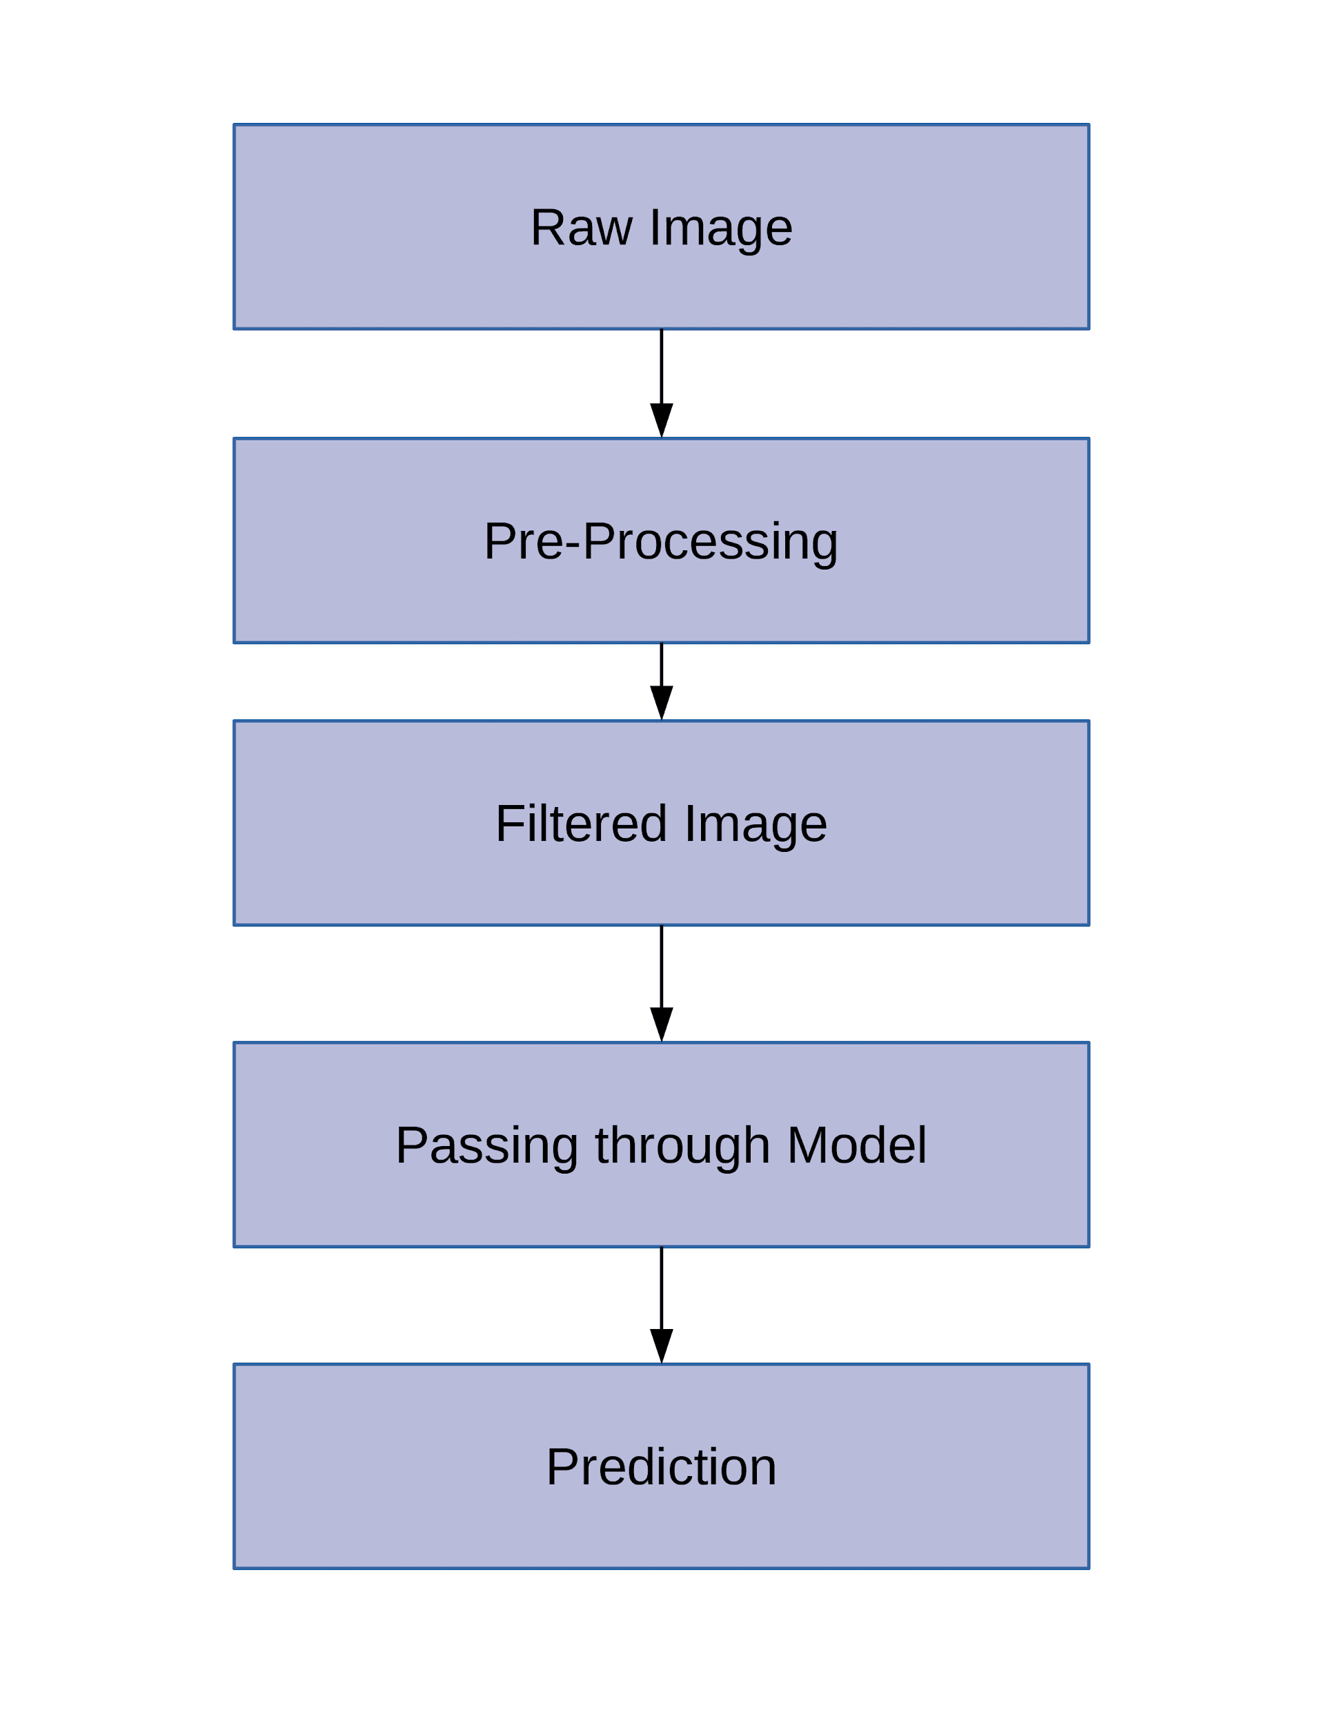
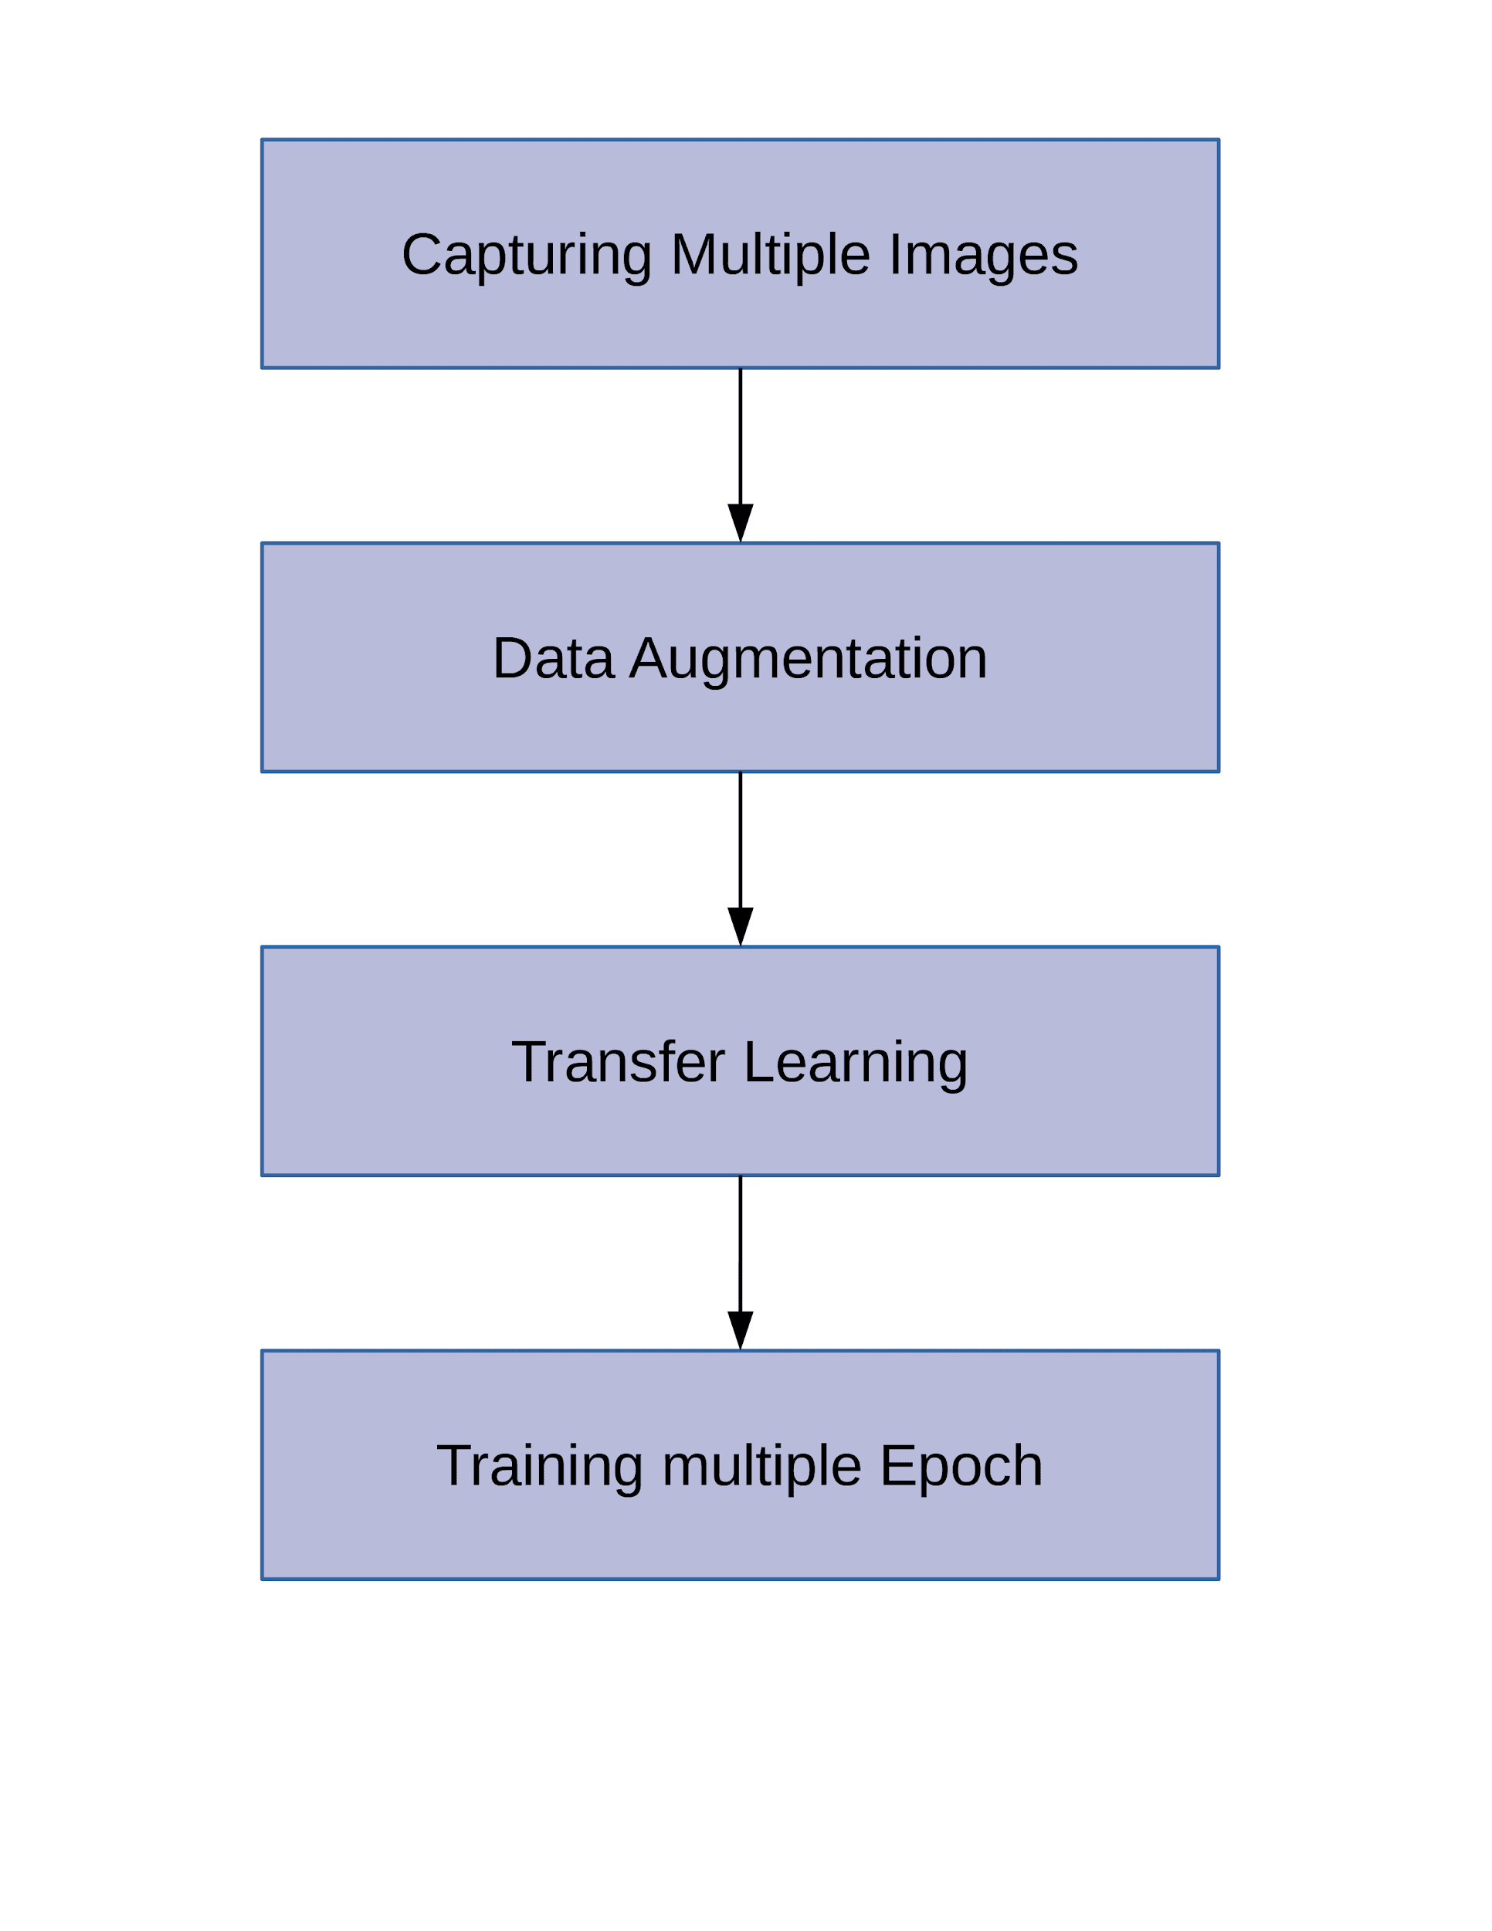
Testing Phase
Training Phase

Slide 12
Problems Faced
Creating the dataset
Manually captured hundreds of pictures in different setups.
Installing correct dependencies
Raspberry Pi uses specific versions of dependencies and libraries.
Hardware problems
Proper calibration of motor speed, sonar sensors and making the bot wireless.
Model Selection and Training
Selecting suitable classifier with minimum loss error.

Slide 13
Possible Work for Future
Increase the accuracy in the prediction of directions.
Reducing the time required for classification.
Voice control to provide override commands.
Send mass classification requests to server and redirection of multiple bots simultaneously.
Multipath traversal using colour coding.

Slide 14
THANK YOU

